Slide 1
Satellite Networking Problems and 3GPP Use Cases draft-lhan-problems-requirements-satellite-net IETF 116 Yokohama, Mar 27-31, 2023
Lin Han (Futurewei, USA)
Tianji Jiang (China Mobile Technologies (USA))

Slide 2
Agenda
Problems (Lin Han)
Satellite Networking Types: Tradition and Future
Large Scale LEO Constellation
Problems
3GPP Use Cases (Tianji Liang)
5G system with satellite backhaul – In progress (Rel-18)
5G Satellite Access Phase 2 – In progress (Rel-18)
5G Satellite Access Phase 3 – In progress (Rel-19)

Slide 3
Problems

Slide 4
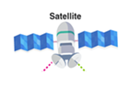
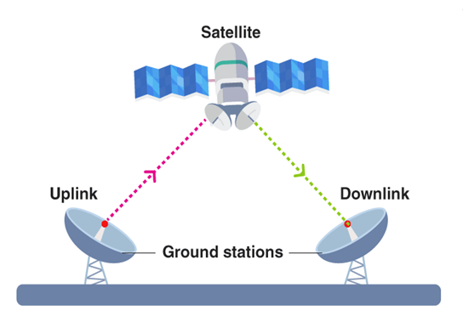



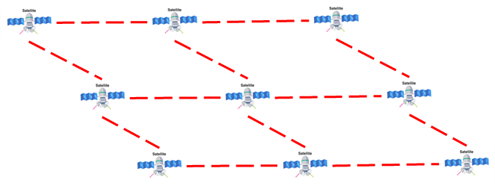
Satellite Networking Types: Tradition and Future
No ISL, GS relay
Internet
Proposed by Mark Handley, UCL
https://www.youtube.com/watch?v=m05abdGSOxY&ab_channel=MarkHandley
Use ISL,
satellites form network
Traditional way, bent pipe
Radio Frequency filtering
Frequency conversion
Amplification
No packet work
No global coverage
Internet
Future way, networking
Regenerative payload
Packet processing
L2 or L3 networking
Large scale networking
Use ISL and GS relay
satellites and GS form network
Internet
4

Slide 5
Large Scale LEO Constellation- Challenges to the current IP networking technologies
LEO satellites move at ~7.x km/s with ~100min period
50% satellites move on different direction with another 50% satellites and form a dynamic interleaved network
Earth is self-rotating at ~463m/s
links between satellites and ground station (GS) will flip every ~5min for LEO satellites (~550 km altitude), distance keeps changing
One satellite has multiple GS connected
One GS has multiple satellites connected
Huge number of Sat-GS links (> million)
ISL distance for satellites on adjacent orbits keep changing
ISL direction swaps on polar areas
Simulation is by savi: https://savi.sourceforge.io/

Slide 6
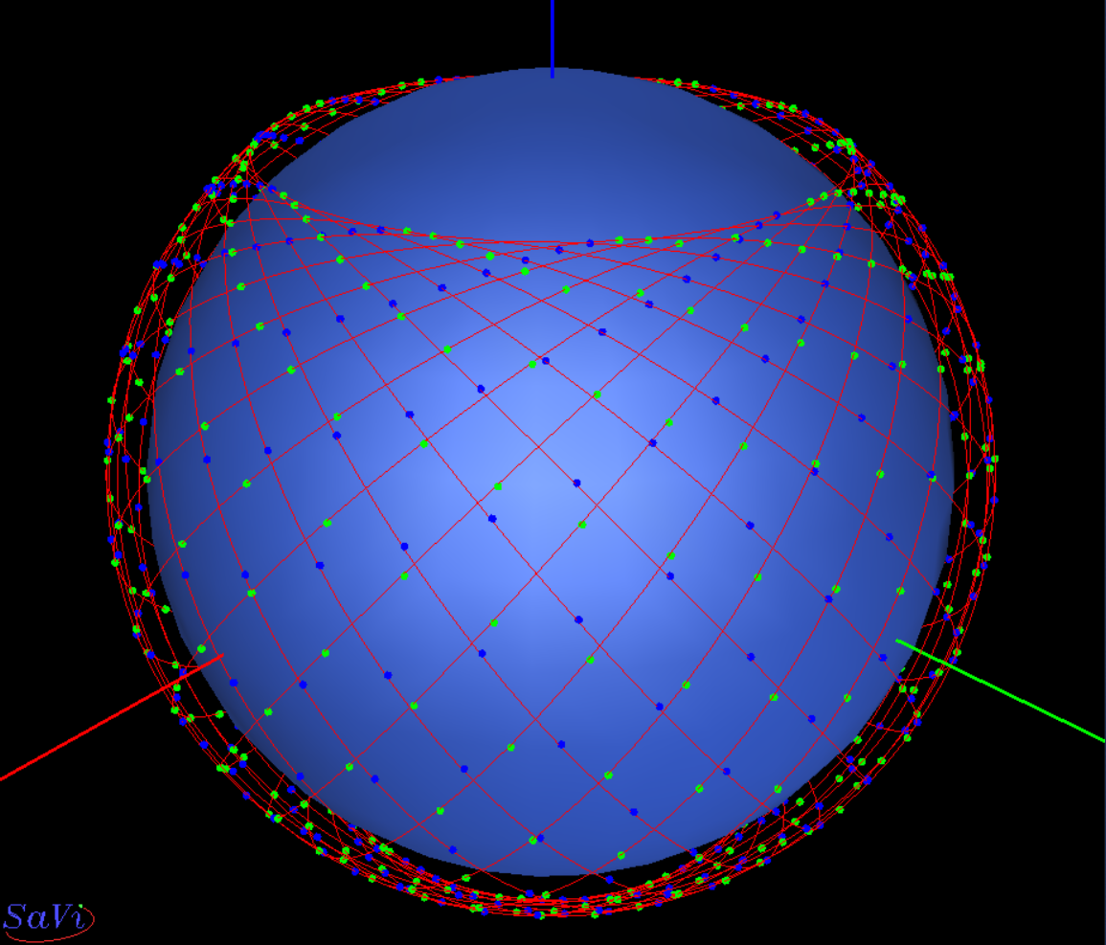
Problems - Connectivity
Satellite moving direction on same orbit
Satellite relative moving caused
by earth self-rotation
Connectivity:
Ground-station to ground-station
Satellite to ground-station
Satellite to satellite
Challenges to routing/switching protocol
Very dynamic network topology and state
Current routing protocol issues
Path determination
Packet forwarding
IGP flooding
Routing Usability
Convergence

Slide 7
Problems - Mobility, Handover, Multi-path
Whole infrastructure network is moving, while the GS is relatively steady
GS-sat links keep switching
Frequently handover is needed
Both ends of communications need handover
Minimize the path interruption/packet loss
Mobility handling
Handover process
Multi-path support
Challenges to Current technologies
Traffic engineering?
Proxy Mobile IPv6 or Mobile IP?
Others?

Slide 8





Problems – NTN integration with 5G and Internet
Satellites support all 5G functionalities
SBA architecture
MEC on satellite
Data switch and UPF on satellite
3GPP provides
5G wireless, SBA, etc
IETF provides:
Address management, DNS
Routing, switching,
Congestion control, TE, QoS/QoE
Route exchanging with Internet
L4 and Upper layer protocols
gNB is IP capable
gNB
Access
?
Core Network
Back haul
GW-GS
PE
Internet
Routes exchanging
PE
?
Core Network
gNB
T-GS
GW-GS

Slide 9
3GPP Use Cases

Slide 10
3GPP Specs related to Satellite neworks
TR.38.811 Study on NR to support NTN (Rel-15)
TR 38.821 Solutions for NR to support NTN (Rel-16)
TR 22.822 Study on using satellite access in 5G (Rel-16)
TR 23.737
(Phase-1) Study on architecture aspects for using satellite access in 5G
(Phase-2) Integration of satellite components in the 5G architecture
TR 28.808 Study on management and orchestration aspects with integrated satellite components in a 5G network (Rel-17)
TR 22.926 Guidelines for extra territorial 5G systems (Rel-18)
TR 24.821 CT aspects of 5GC architecture for satellite networks (Rel- 17)

Slide 11
Satellite Network for 3GPP Wireless Access*
+--------------+ +---------+ +-------------+ +--------+
| T or | |Satellite| |Mobile Access| |Internet|
| Local network+---+ Network +---+ Network +---+ |
+--------------+ +---------+ +-------------+ +--------+
End user terminal or local network access Internet
through Satellite Network and Mobile Access Network
Satellite Network for 3GPP Wireless Backhaul*
+--------------+ +-------------+ +---------+ +--------+
| T or | |Mobile Access| |Satellite| |Internet|
| Local network+----+ Network +----+ Network +----+ |
+--------------+ +-------------+ +---------+ +--------+
End user terminal or local network access Internet
through Mobile Access Network and then Satellite Network
*From our IETF I.D: draft-lhan-problems-requirements-satellite-net-04

Slide 12
3GPP SA2 Satellite Backhaul (Rel-18, on-going)
Satellite backhaul:
UPFs on board-SAT w/ gNB on the ground
Backhaul categories: GEO BH, LEO BH, and LEO BH w/ ISL (Inter-satellite-link)
Edge computing deployment vs. on-board Satellite
KIs over SATB:
Service provisioning & QoS control enhancement with dynamic satellite backhaul
UE local data switch with UPF on-board (Inter-satellite-link)
Satellite-based edge computing with UPF on-board
LEO-BH w/ multi-ISL
Extremely dynamics for LEO network
Satellite peering relationship changes roughly every 6~7 min thanks to orbital movements: impair perf, stability, and even cause connectivity-loss.
Currently, no proper technologies to provide steady IP transport for SAT backhaul, impact service.
Thus, currently focusing on the category of (dynamic)_GEO backhaul only.

Slide 13
Use Case: LEO w/ Multi-ISL as a 5G Backhaul*
Two multi-hop ISL paths:
UEs rely on a multi-hop ISL path to connect to 5GC on the ground
Two UEs communicate via the local data switching on satellite(s) (N19 ISL)
Sat#: Satellite GS: Ground Station
UPF: User Plane Function (5G) gNB: Next Generation NodeB
Sat#1
+----------+ +--------+
| UPF#1 | (ISL) | Sat#.. |
UE#1--gNB#1--|(on-board)|- - - -| |-----+
+----------+ +--------+ |
: | --------
:(N19) v / \
:(ISL) GS ---+ 5G Core +
: ^ \ /
+----------+ +--------+ | --------
| UPF#2 | (ISL) | Sat#.. | |
UE#2--gNB#2--|(on-board)|- - - -| |-----+
+----------+ +--------+
Sat#2
Some multi-ISL related challenges (dynamic topology, transmission capabilities, etc.):
UE-to-UE session time over 6~7 min – topology/peering changes, link-cost varies, etc.
UEs belonging to the same 5G-VN group, i.e., 5G LAN-type service w/ PSA UPF
So, need standardized & efficient satellite-based routing protocols (if possible) for more efficient satellite communication
Of course, the ‘dynamics’ talked about here is ‘not random’ – the movement of a satellite is normally periodic and could be well predicated based on the operational information of satellite constellation; meaning more predictably easier & better services.
*From our IETF I.D: draft-lhan-problems-requirements-satellite-net-04

Slide 14
3GPP SA2 Satellite Access (Ph2, Rel-18, on-going)
To investigate & study 5GC enhancements to support the satellite-based wireless access under the discontinuous coverage:
Architectural enhancements to support mobility management with discontinuous satellite coverage
Study how UE determines that it has to remain with no service or it has to attempt to register on available different RAT's/ PLMNs to receive the normal service during discontinuous coverage in current NTN RAT.
Study how to reduce the impact to target RAT or system due to large number of UEs triggering signaling load on the target RAT or system to receive normal service.
Architectural enhancements to support power-saving optimization in discontinuous coverage (considering prediction, awareness, etc.)
whether and how to enhance the power saving mechanisms, e.g. PSM, MICO mode and eDRX in CM-IDLE state, in order to make sure that a UE does not attempt PLMN access when there is no network coverage;
when there is network coverage the UE attempts PLMN access as needed e.g. to transfer signaling, transfer data or receive paging, etc.
There are 20+ solutions proposed; one predominant point (from multiple solutions) based on UEs obtaining predictable satellite footprints (e.g. ‘ephemeris’) – Satellite routing information.

Slide 15
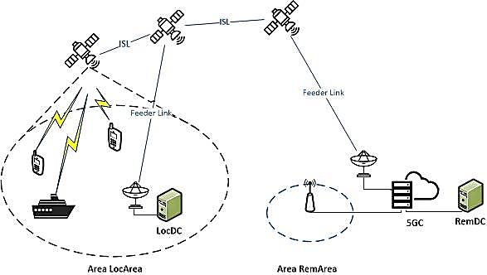
3GPP SA1 Satellite Access (Ph3, Rel-19, on-going) : - Use-case study on service requirements via satellite access taking into account 5G new capabilities
UE-to-UE communication via satellite(s) without going through the ground network: In some scenarios, UEs need to communicate using satellite access without going to the ground network in order to avoid long delays and limited data rate as well as reducing the consumption of backhaul resources; sometimes, to provide communication services for UEs without a simultaneous active feeder link connection to the ground segment.
Varied use cases, e.g., UE LAN using satellite access, information collection via satellite connections for terrestrial network planning, etc.

Slide 16
Conclusion & Next Steps
Satellite constellation network and communication service are critical for 3GPP
(SA2) WID: 5GSATB: 5G system with satellite backhaul – In progress (Rel-18)
(SA2) WID: 5GSAT_Ph2: 5G Satellite Access Phase 2 – In progress (Rel-18)
(SA1) SID: 5GSAT_Ph3: 5G Satellite Access Phase 3 – In progress (Rel-19)
Keep following up with 3GPP SA WGs on 5G SAT use case
Note that, while the SA projects have not currently considered the multi-ISL transmission as a core requirement yet, we do project it will gain more traction in the following releases (e.g. already a very attractive research aspect for B5G/6G)
B5G/6G visionary:
NTN integration
Global coverage
large-scale LEO w/ high perf/BW/QoS requirements
UE-to-satellite direct connect
Satellite network being the infrastructure for wireless access and Internet, it provides the gNB, front haul and back haul transport functionalities.
A satellite network could be shared by different SPs to provide services, which means standardized protocols are necessary for many functionalities.

Slide 17
Summary
Large scale LEO satellite network is key for NTN integration for 3GPP’s view for 5G and beyond.
LEO satellite network work as both wireless access and IP back haul network, and need to support all 5G functionalities
From 3GPP perspective, IETF can provide set of under-layer (IP) solutions for LEO satellite networking integrated with Internet.
Proprietary technologies cannot satisfy 3GPP requirements, e.g. gNB on satellite, MEC/UPF on satellite, SBA on LEO constellation, Sharing of LEO constellation with different SP, etc.

Slide 18
Thanks

